Slide 1
Digital Portfolio
STUDENT NAME: JUSTIEN CHARLES . A
REGISTER NO AND NMID: D6830E90F0F0C019A514D7439D505CC9
DEPARTMENT: BCA
COLLEGE: Apollo Arts And Science College Chennai /
MADRAS UNIVERSITY

Slide 2
PROJECT TITLE
PERSONAL PORTFOLIO WEBSITE USING FRONT-END DEVELOPMENT

Slide 3


AGENDA
Problem Statement
Project Overview
End Users
Tools and Technologies
Portfolio design and Layout
Features and Functionality
Results and Screenshots
Conclusion
Github Link
3/21/2024 Annual Review

Slide 4

PROBLEM STATEMENT
Static resumes cannot reflect creativity and hands-on coding experience.
Lack of an interactive platform to showcase web development projects.
Solution: A modern portfolio website highlighting skills, creativity, and projects.

Slide 5

PROJECT OVERVIEW
This project is a personal portfolio site designed to:
Introduce myself as a web developer.
Present skills through live projects.
Provide an easy way to connect (Contact form).
Build a professional digital identity.

Slide 6

WHO ARE THE END USERS?
Recruiters - to evaluate creativity & coding projects.
Faculty & classmates - academic presentation &evaluation.
Clients/ Audience - explore my work & potential collaborations.

Slide 7

TOOLS AND TECHNIQUES
HTML, CSS, JavaScript - front-end design & interactivity.
Responsive Design - works across devices .
Code Pen/ GitHub - hosting & version control.
Creative Layouts - clean Ul, modern design.

Slide 8
PORTFOLIO DESIGN AND LAYOUT
Hero Section - name + tagline with gradient background.
About Me - simple intro with profile photo.
Projects Section - 3 showcase projects.
Webity - making ideas into websites.
b. Intera Web - focus on interactive design.
c. Vision Grid - structured yet creative layouts.
Contact Me - form for communication.
8

Slide 9
FEATURES AND FUNCTIONALITY
Fully responsive across devices.
Modern & minimal user interface.
Project highlights with descriptions.
Integrated contact form.

Slide 10
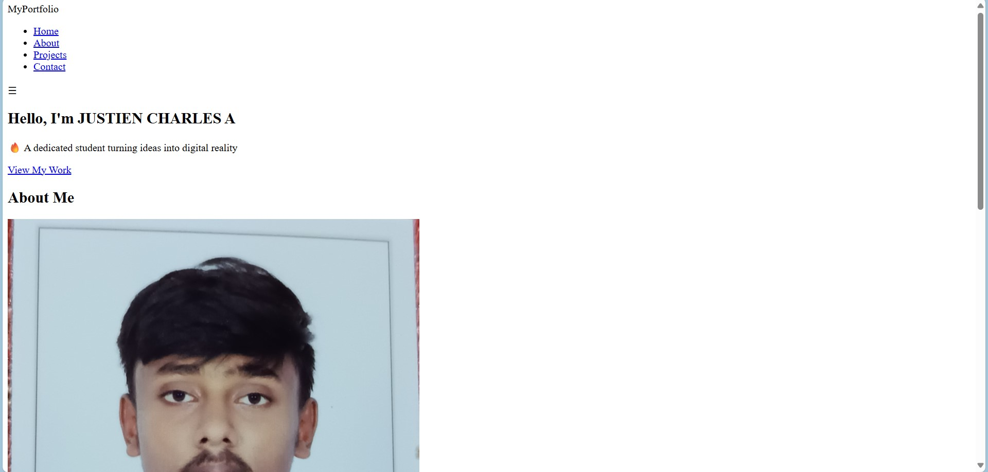
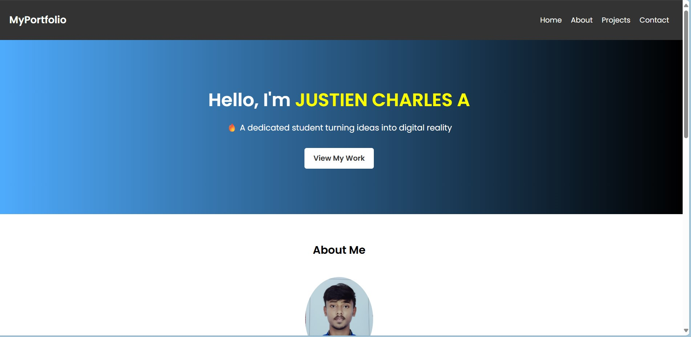
RESULTS AND SCREENSHOTS
BEFORE ADDING CSS : AFTER ADDING CSS:
3/21/2024 Annual Review
10

Slide 11
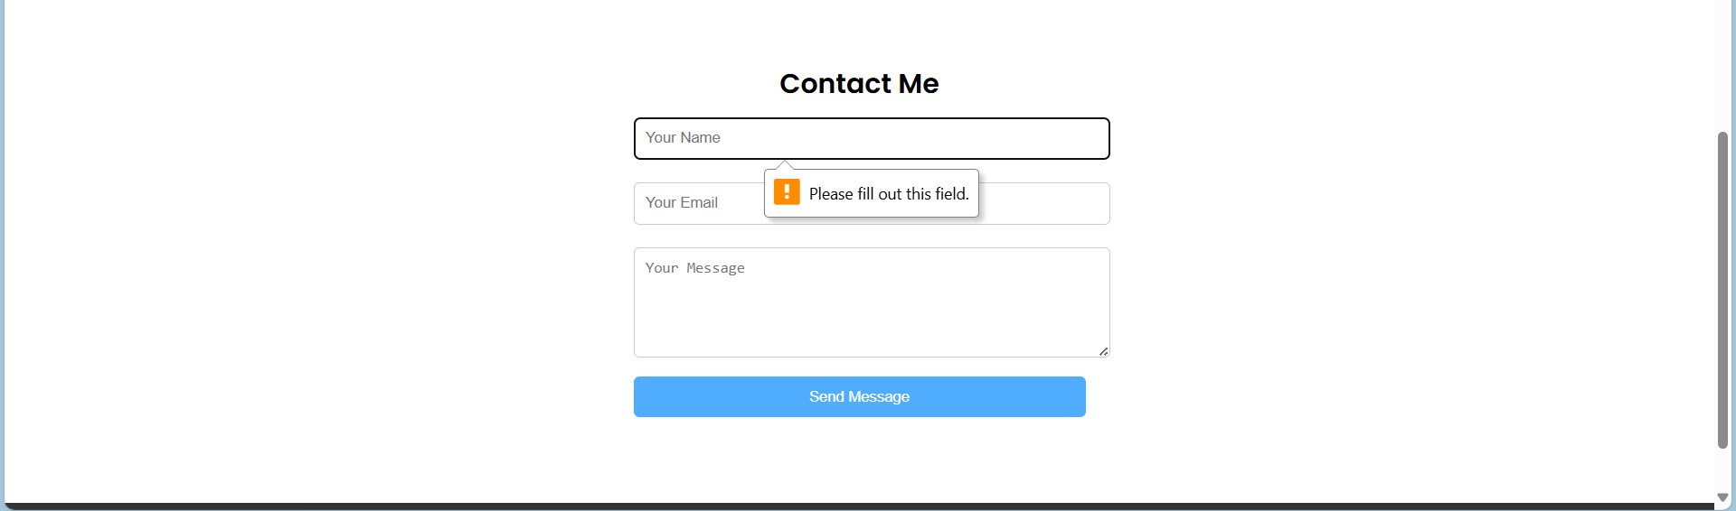
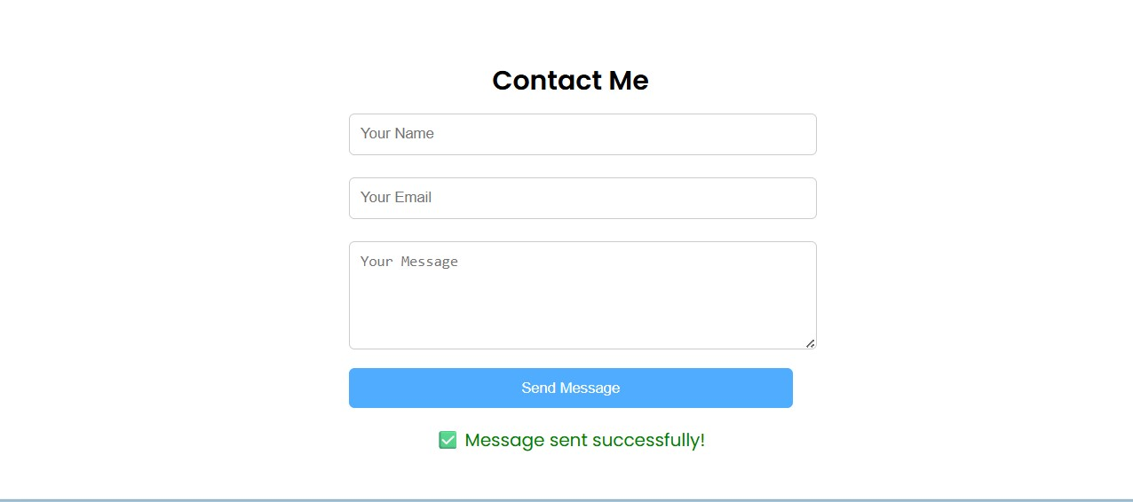
JAVA SCRIPT IMPLEMENTATION:

Slide 12
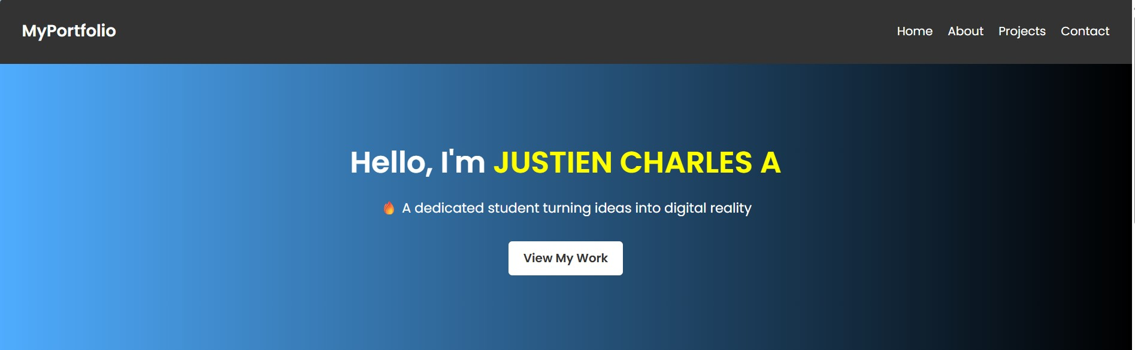
HOME SECTION:

Slide 13
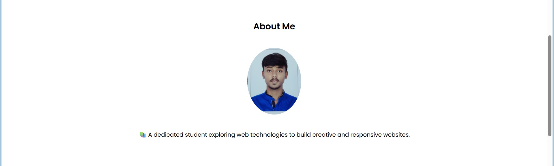
ABOUT SECTION

Slide 14
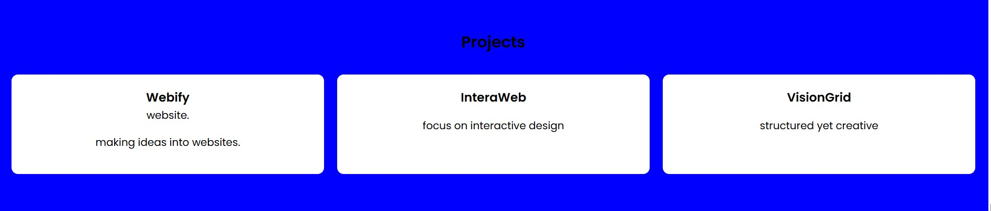
PROJECT SECTION:

Slide 15

CONTACT SECTION:

Slide 16
CONCLUSION
Built a professional, responsive, and creative portfolio website.
Enhances personal branding & career opportunities .
Future scope: Adding more projects, certifications, and animations.
16

Slide 17
GITHUB LINK:
https://justiencharlesbca24aascc-byte.github.io/TNSDC-FWD-Digitalportfolio/

